Slide 1


Printable Robotic Boat Swarms With Actuation and Sensing Capabilities
Grace Kwak
gracekwak@ucla.edu
Grace LEMKwak

Slide 2
Robot design
Possible designs
Theoretically possible designs
Actualized designs

Slide 3
Who can design robots?
🕑
🤖
💵
🏫

Slide 4
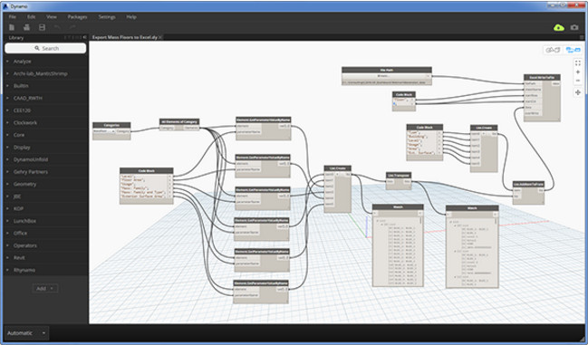
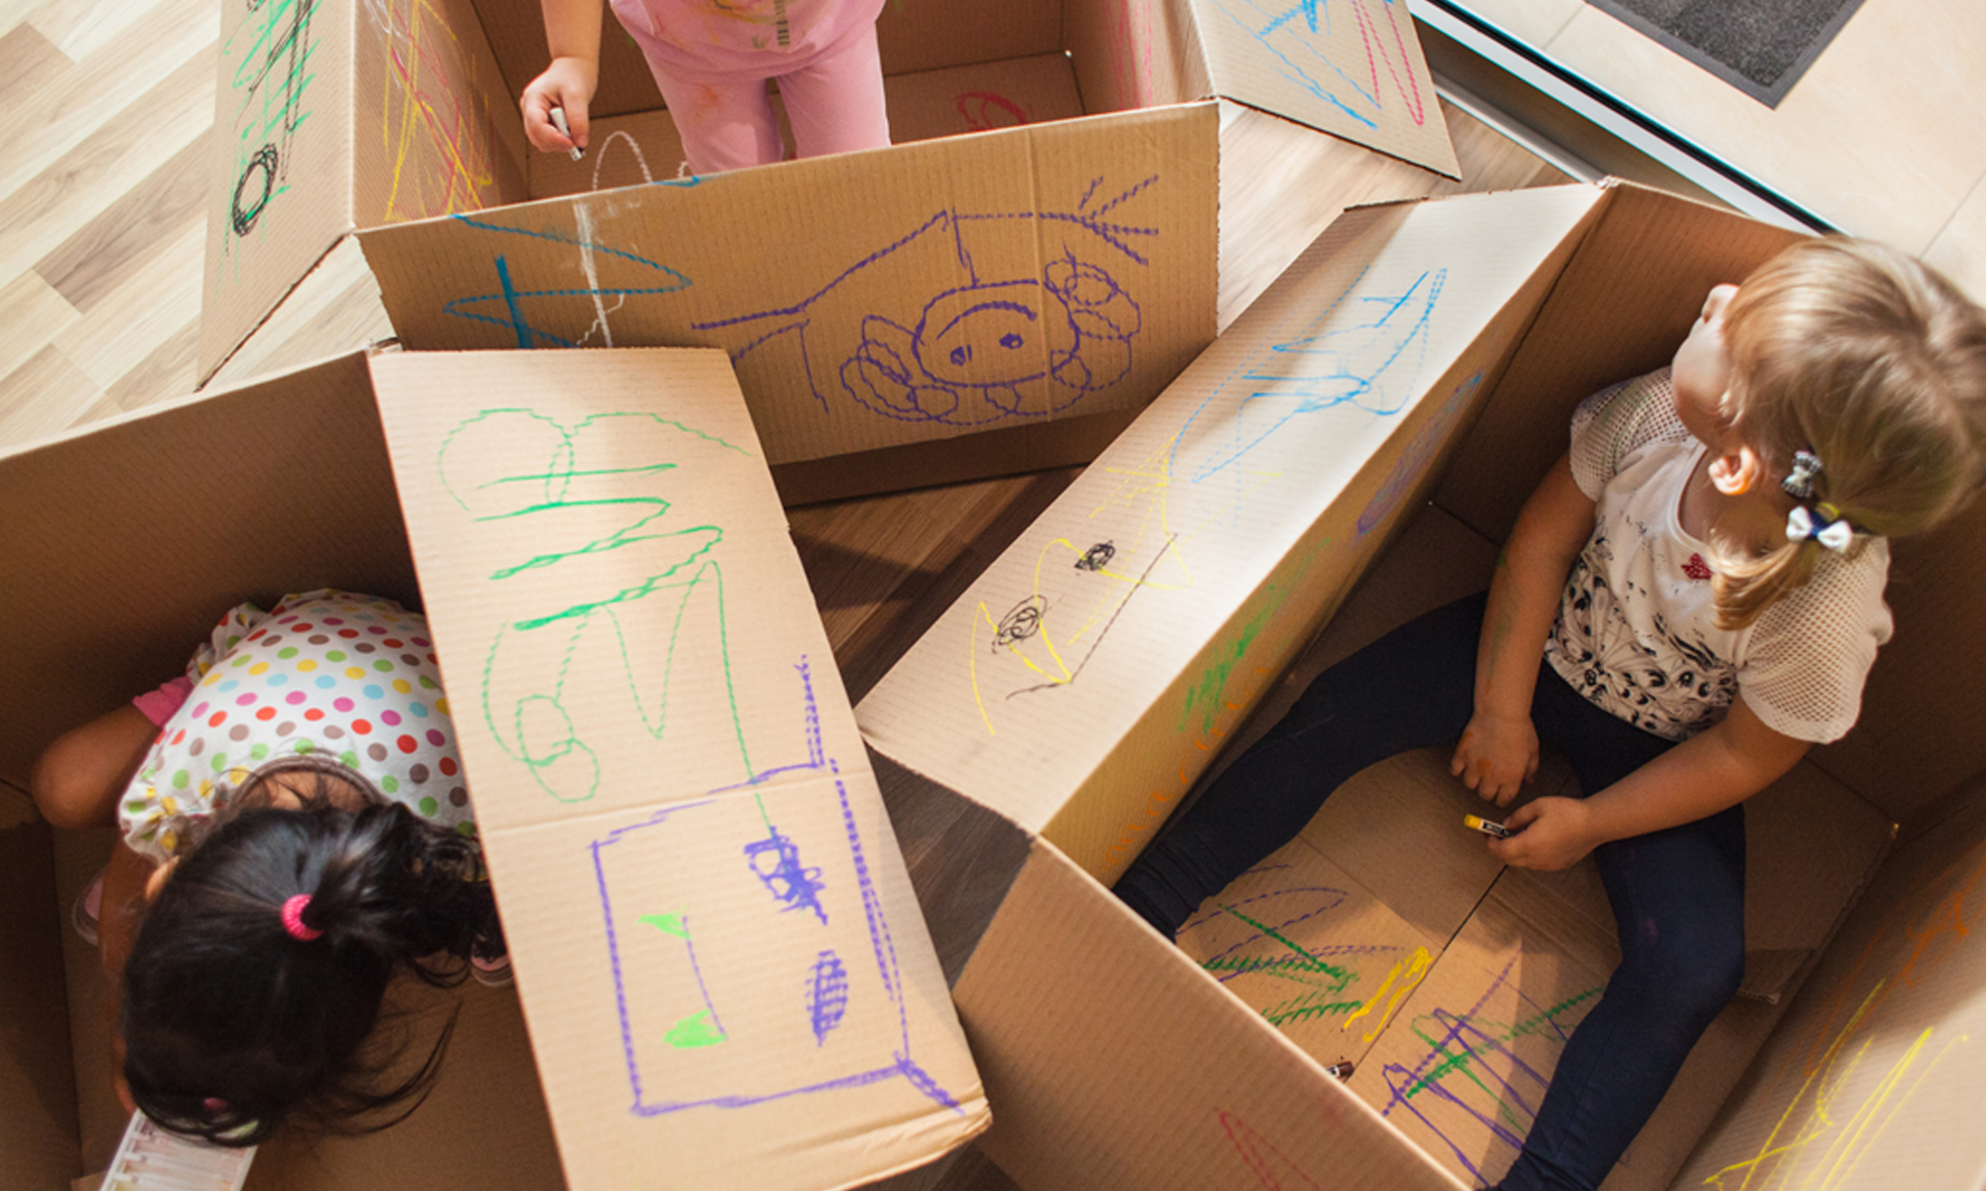
Untapped potential
Source: ArchDaily.com
Source: TED Ideas

Slide 5
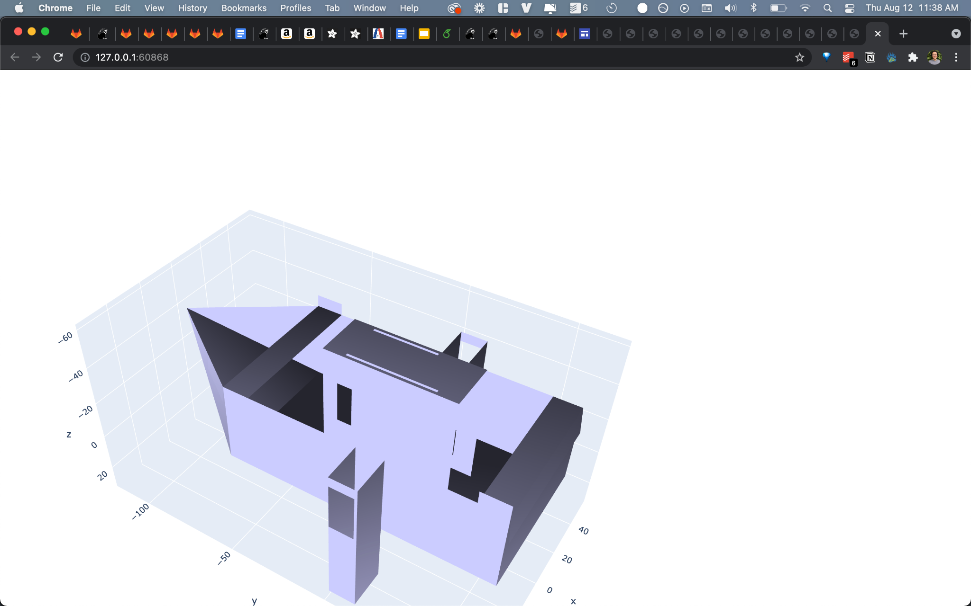

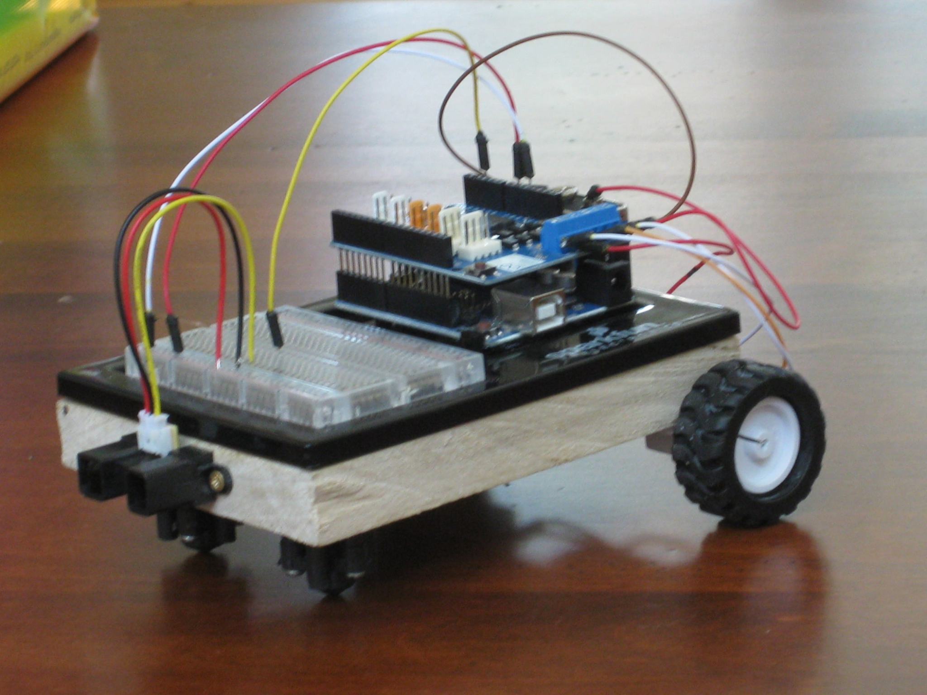
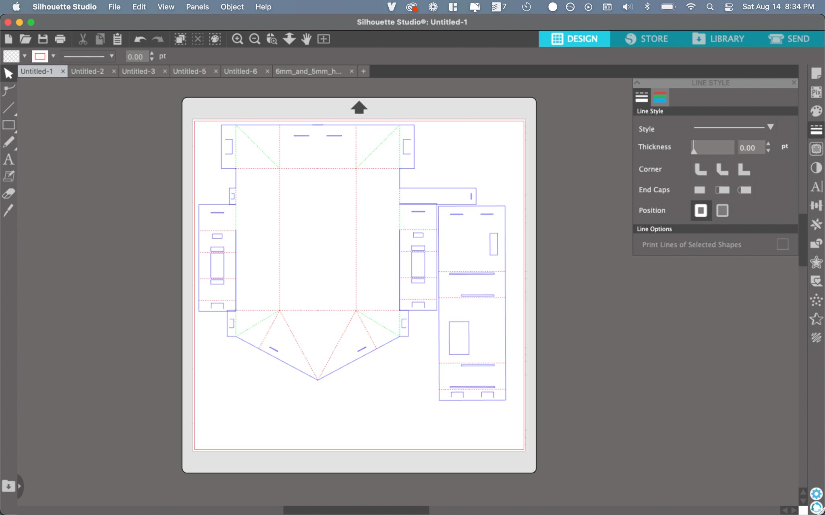

Prior work
Source: Instructables

Slide 6
Easily remixable designs
Base Designs
Theoretically possible designs
Modularity
Parameterization

Slide 7
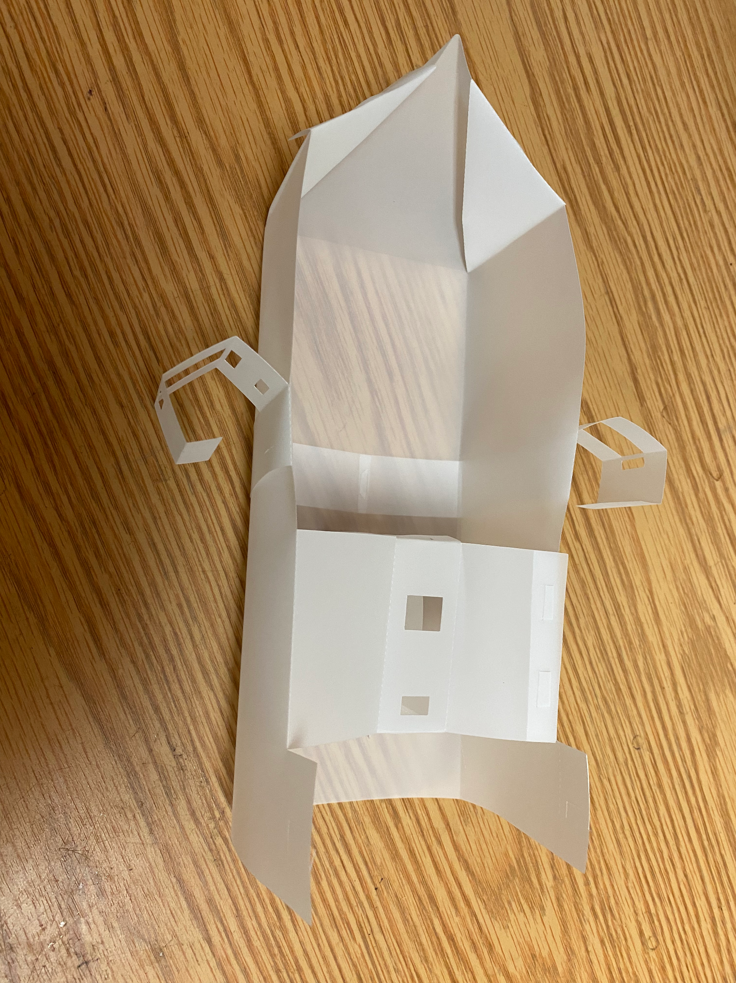
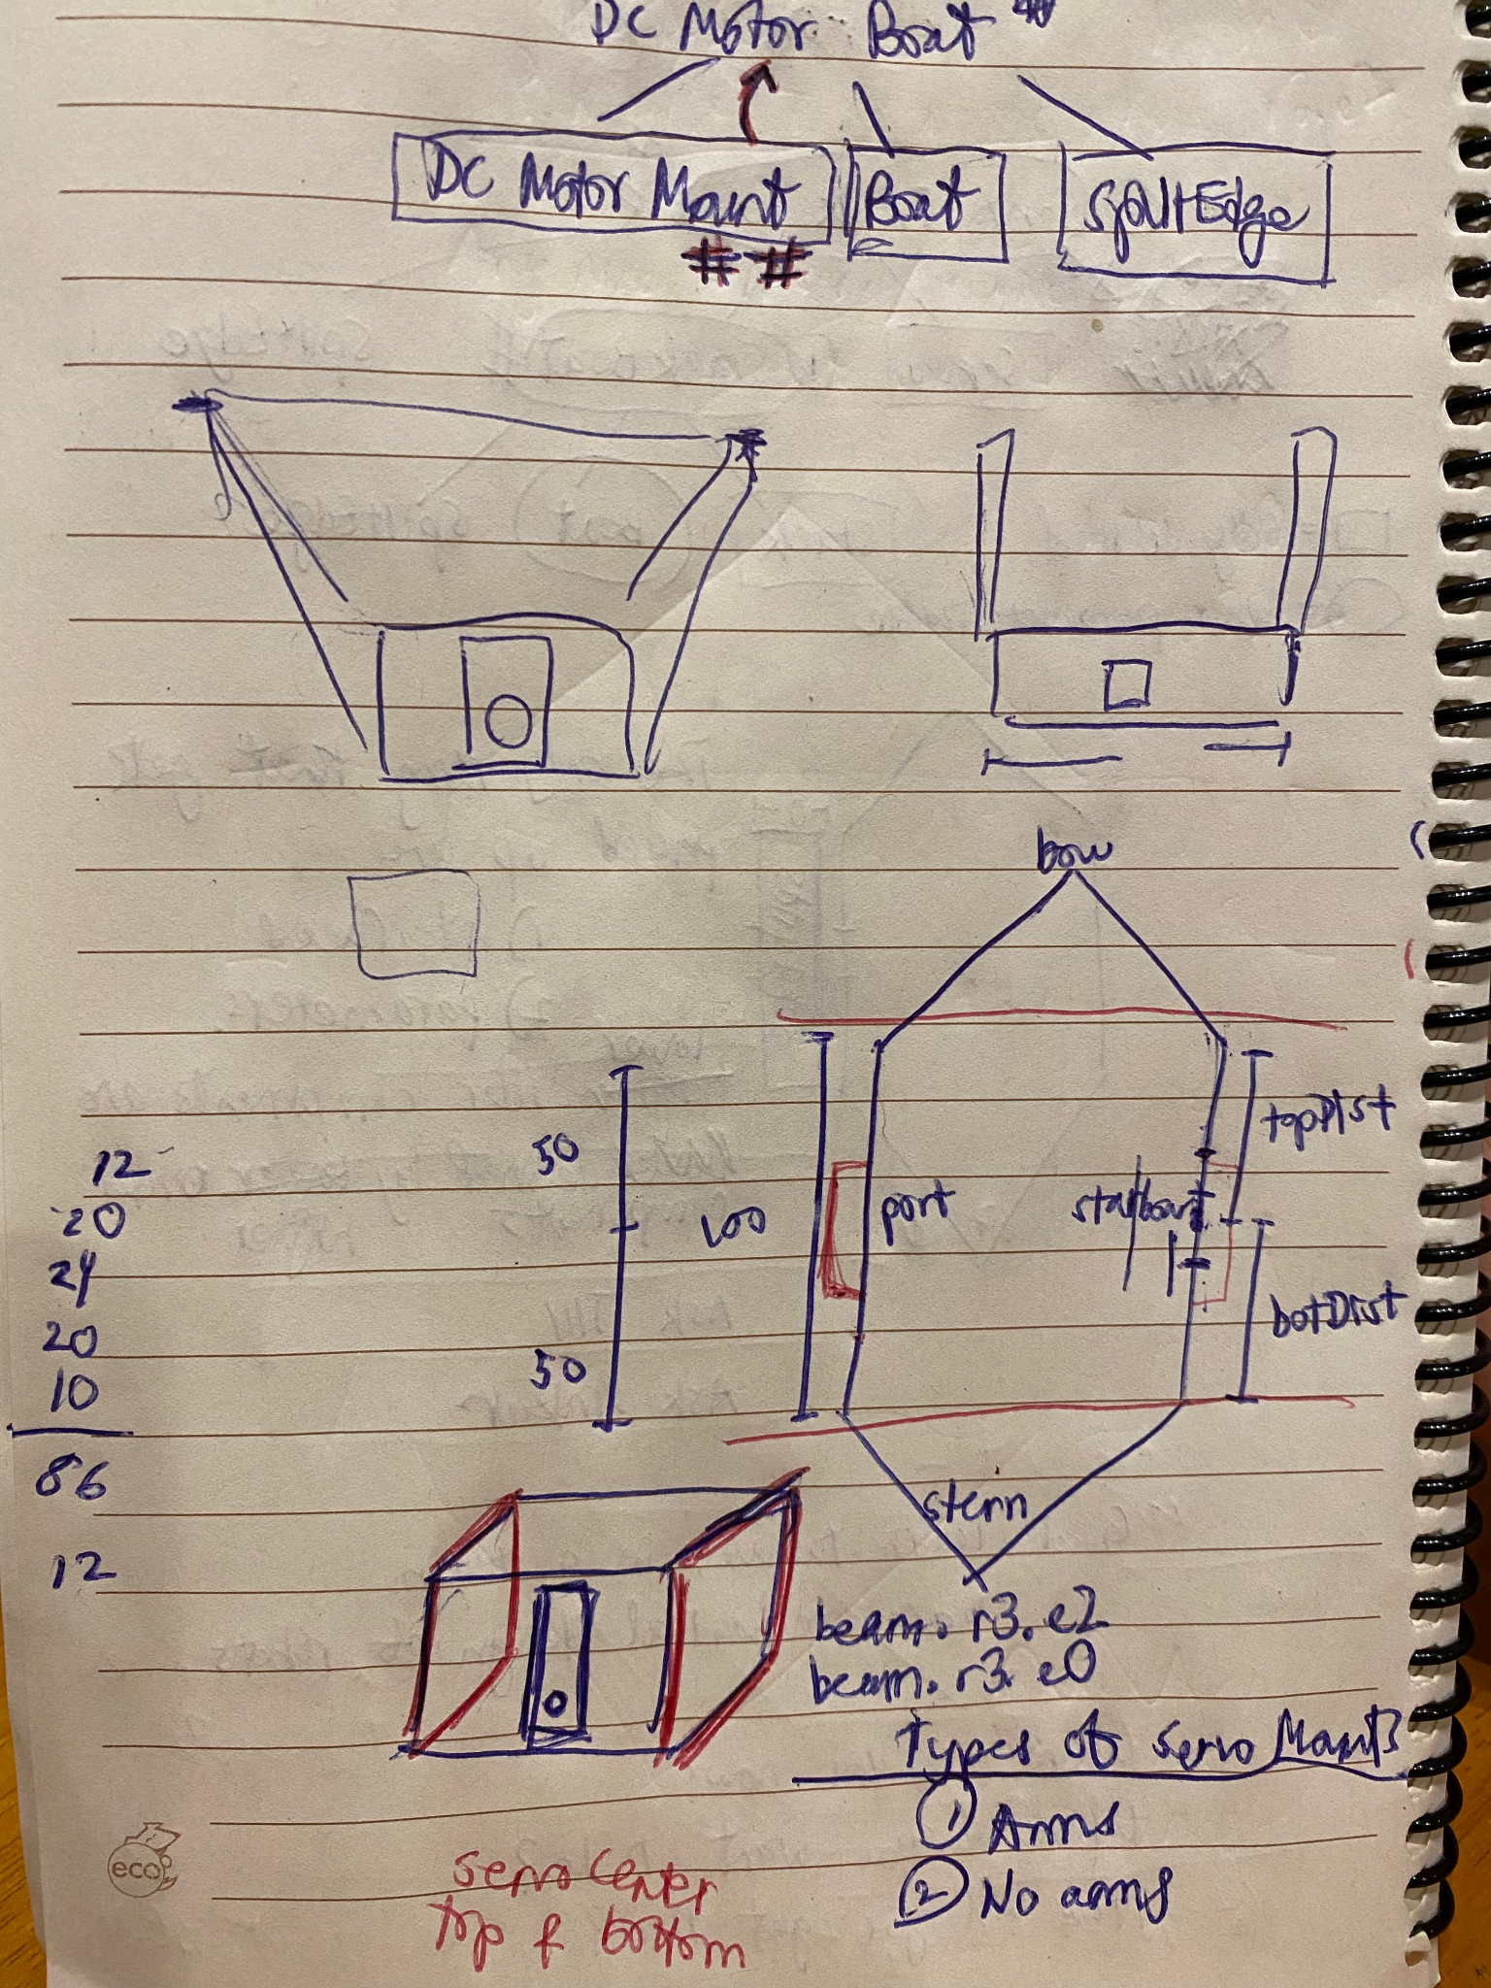
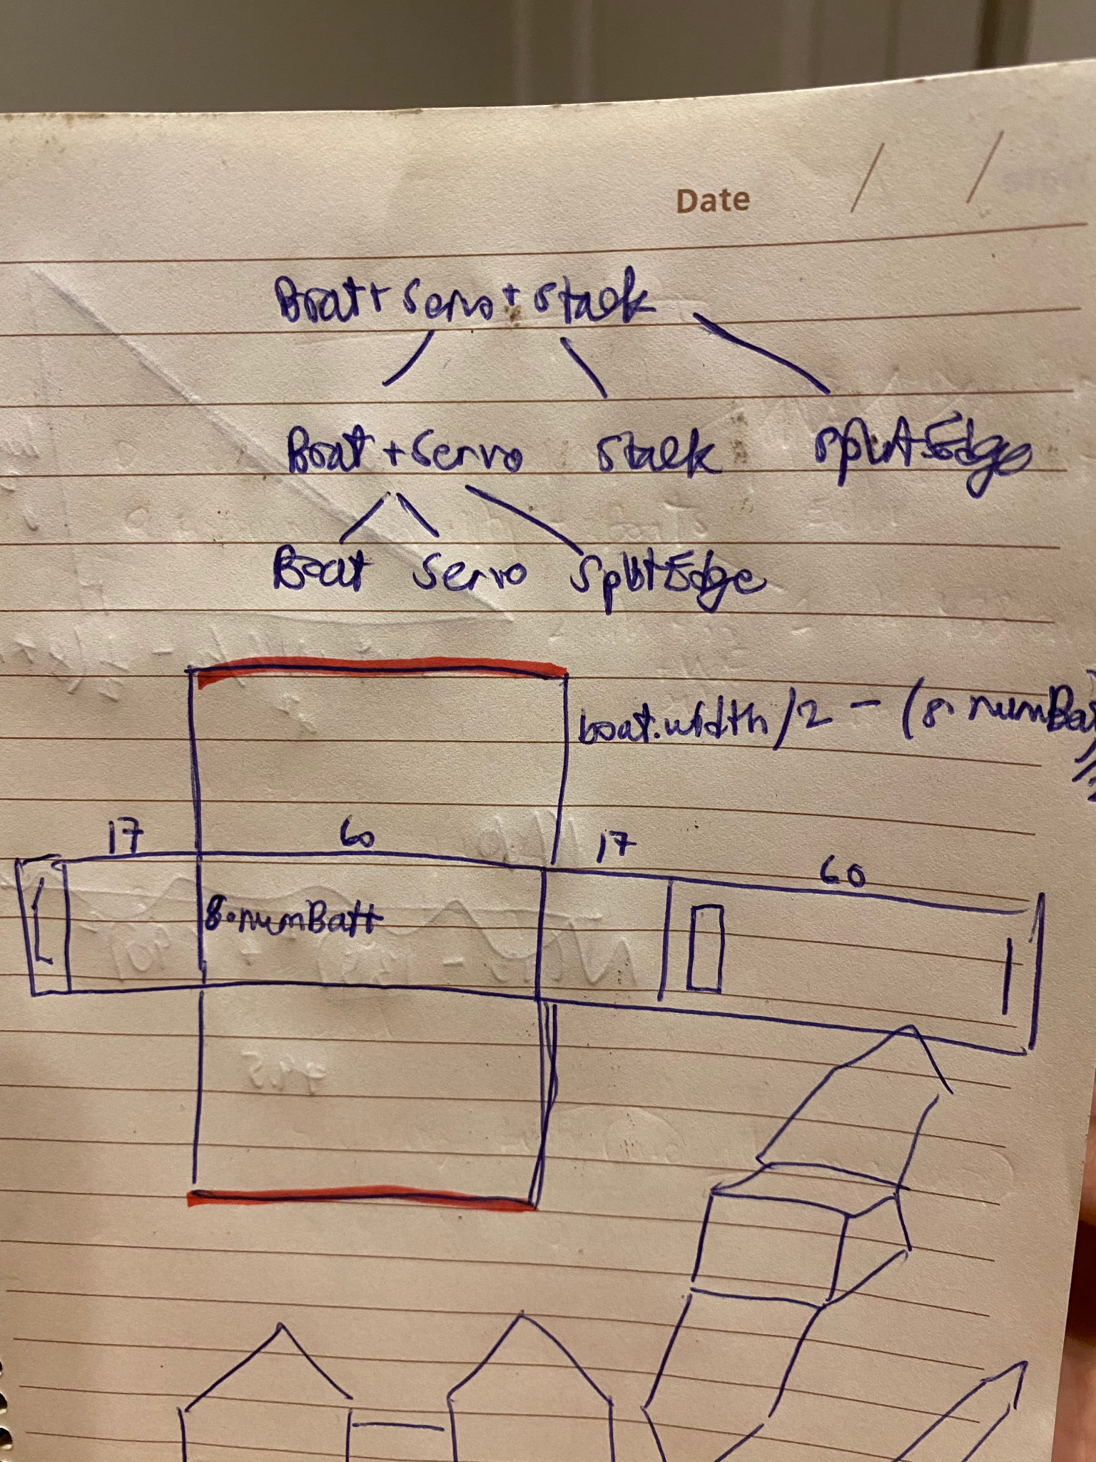
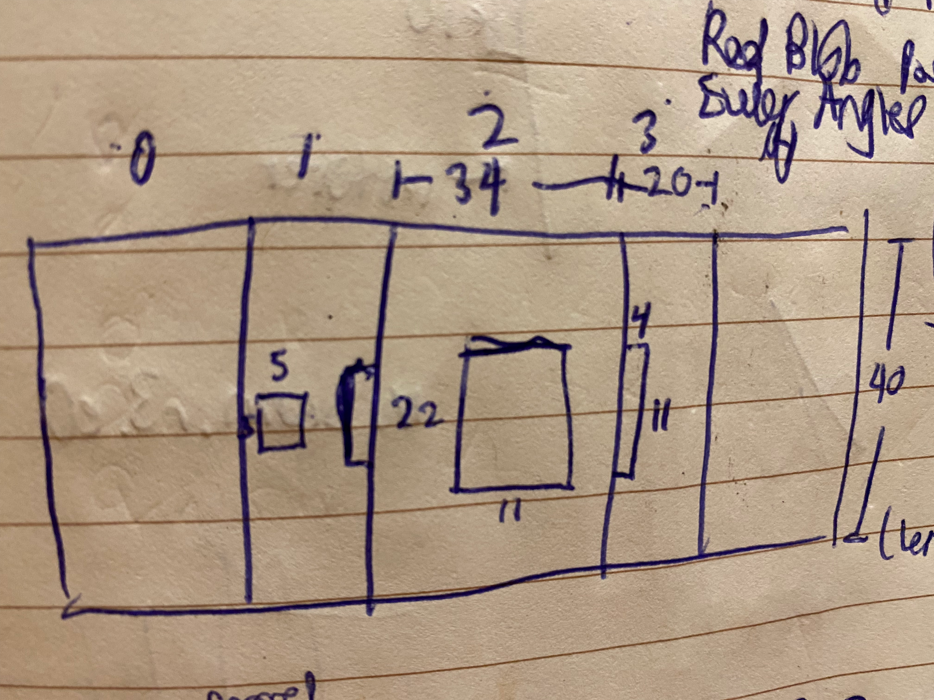
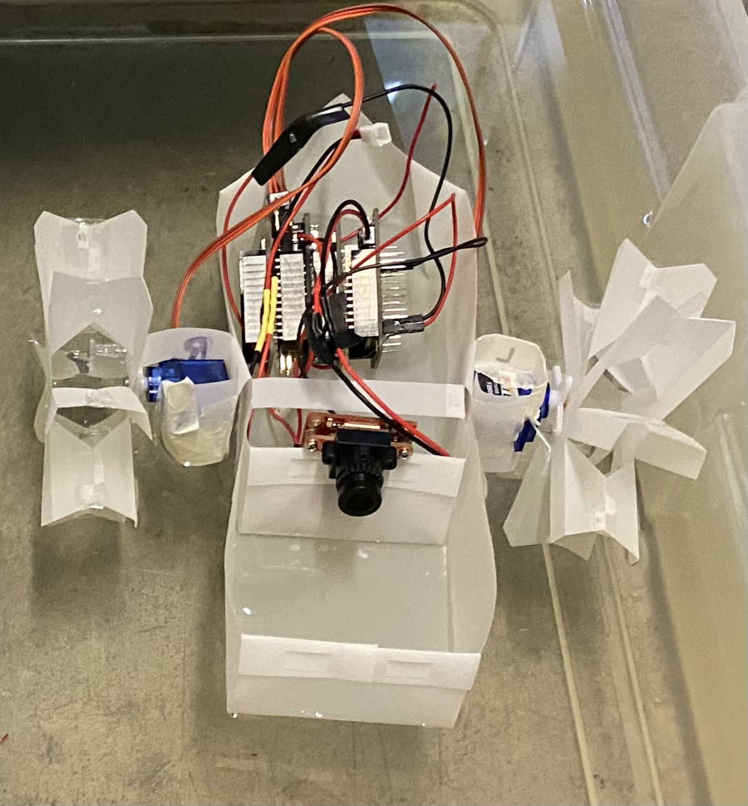
Design Process
Fold
Sketch
Code

Slide 8
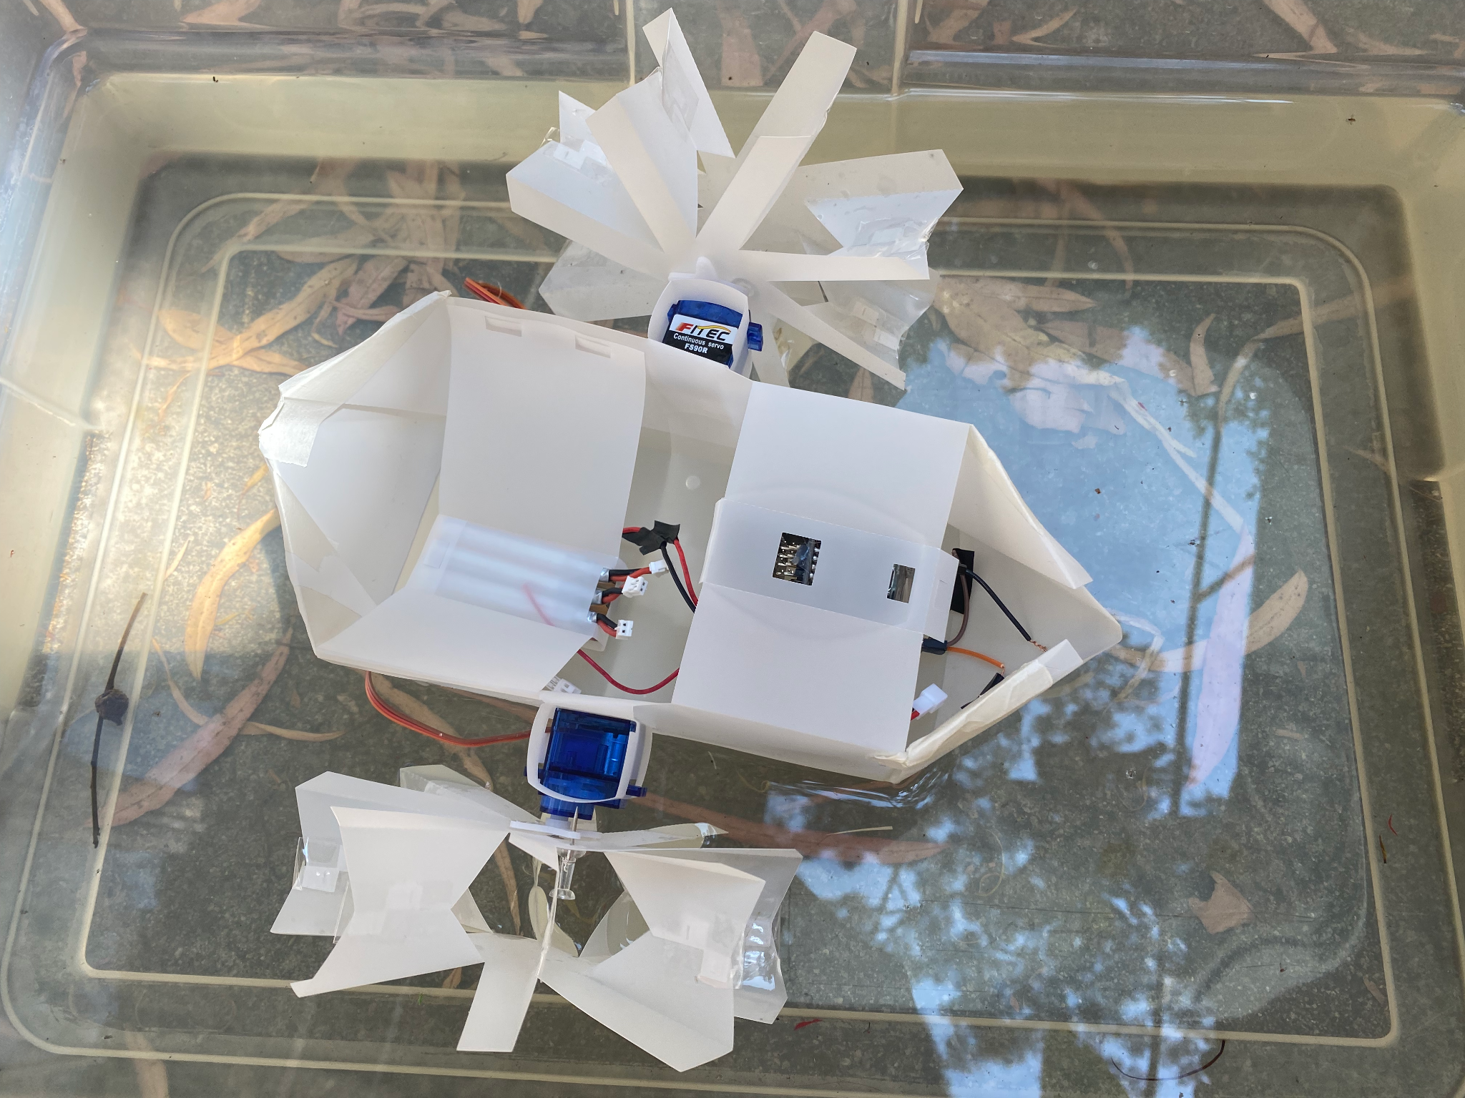
Paddle-wheels
Servo motor

Slide 9
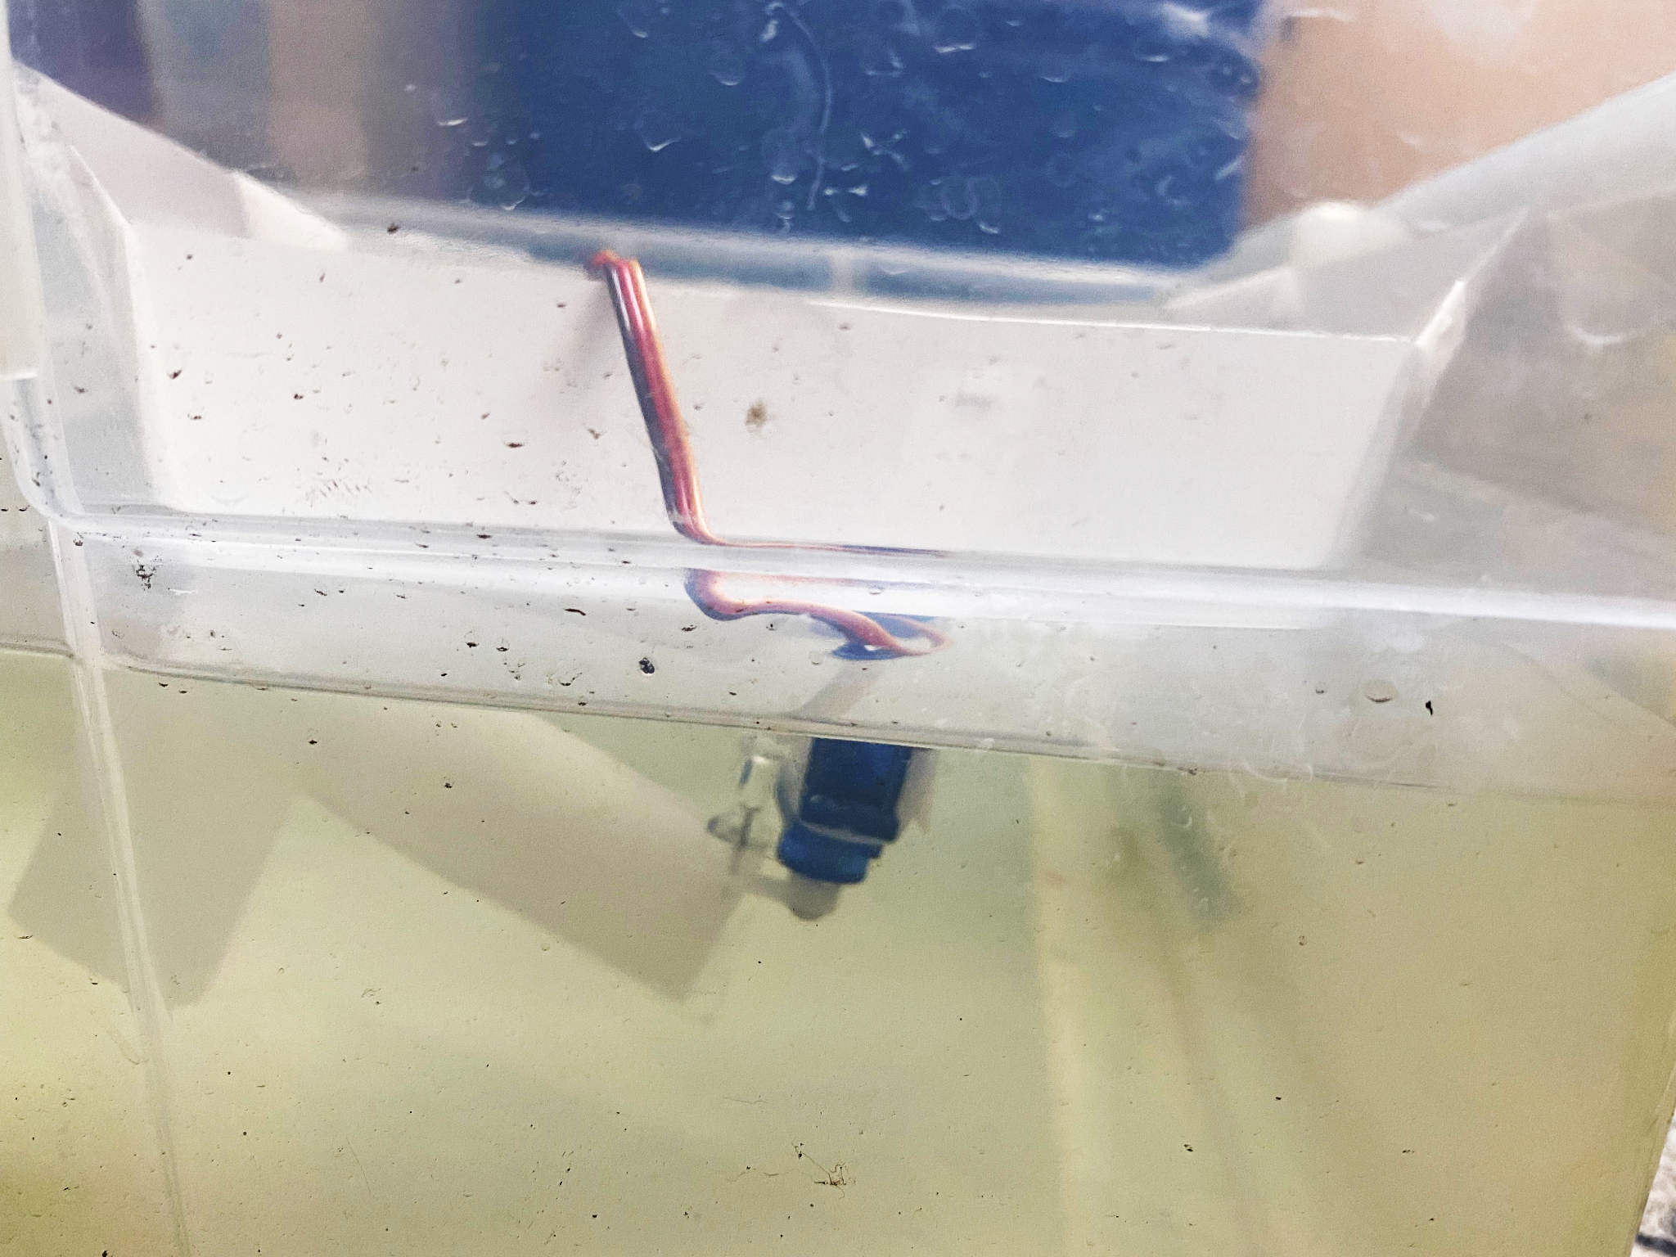
Rudder
Servo motor

Slide 10
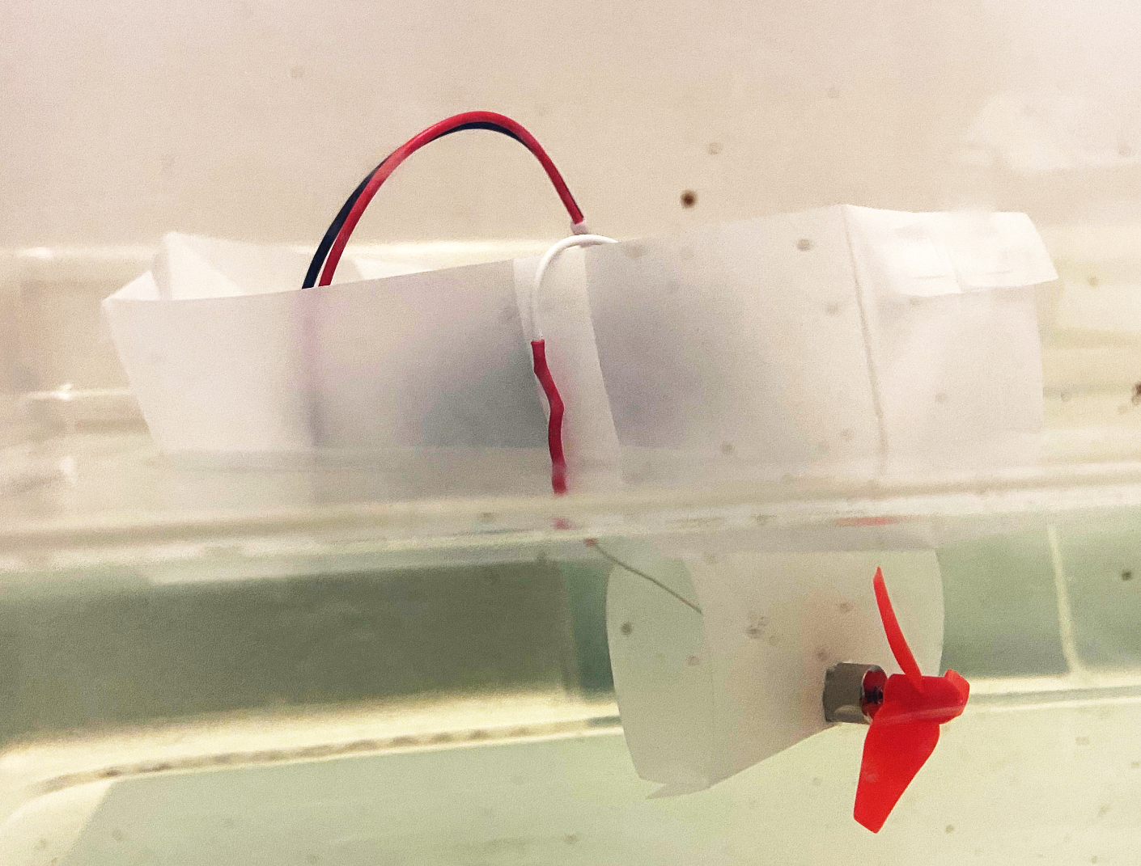
Propeller
DC motor

Slide 11
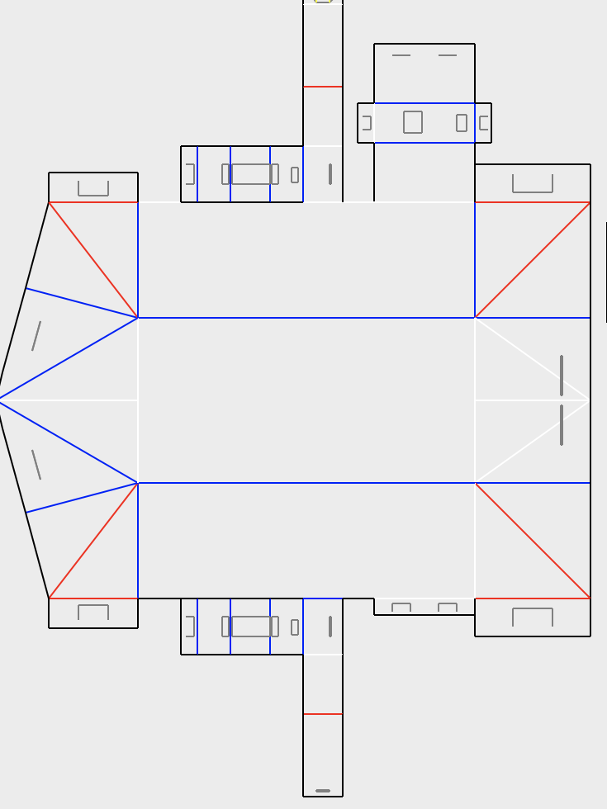
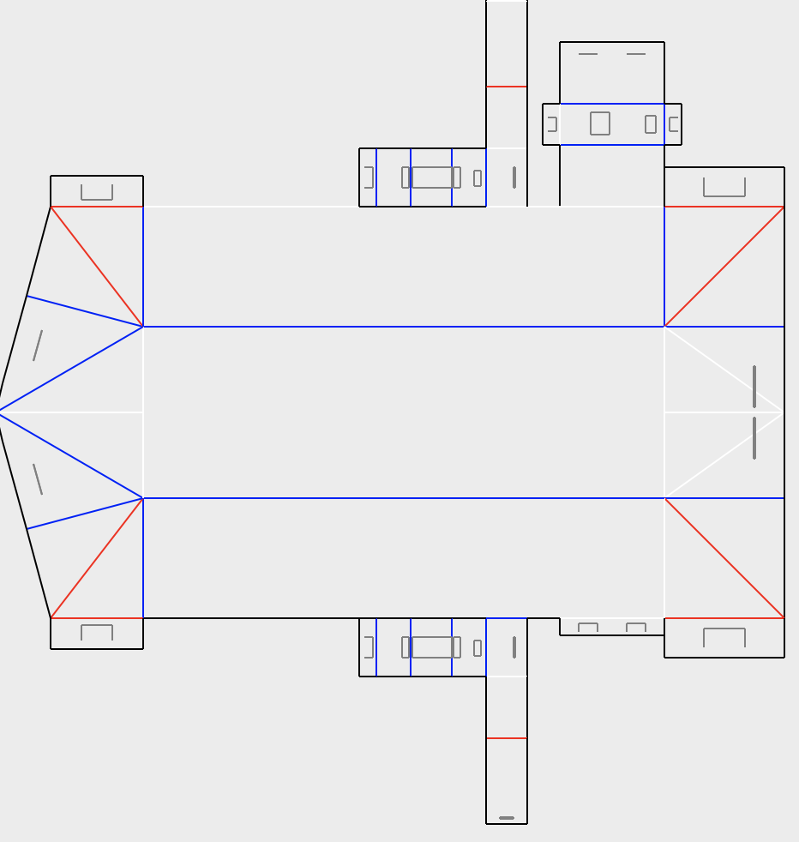
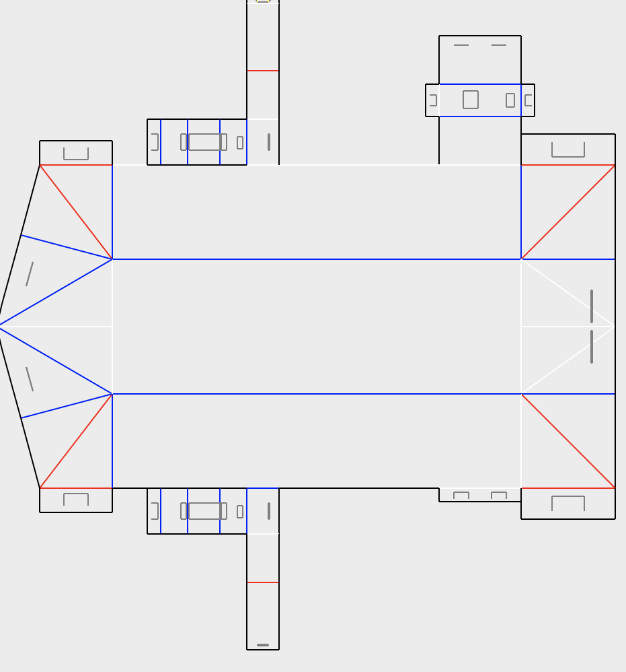
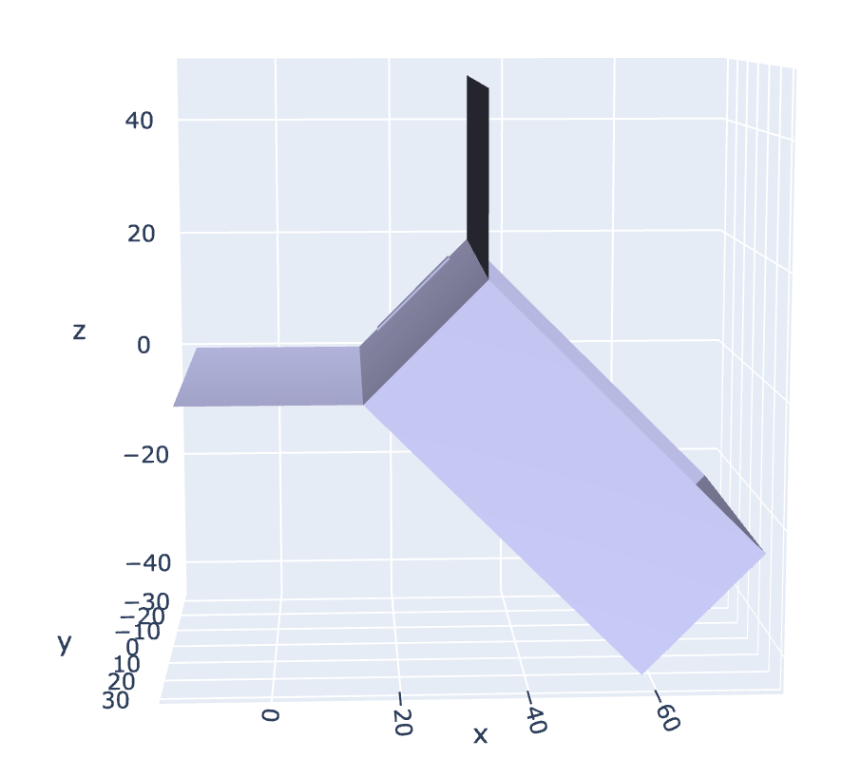
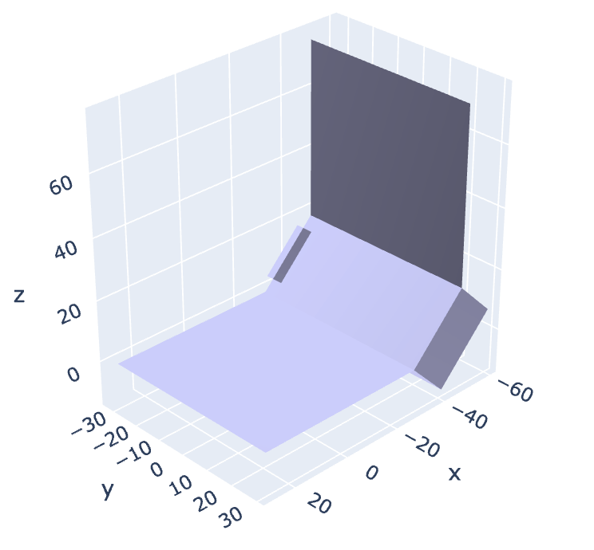
Parameterization

Slide 12
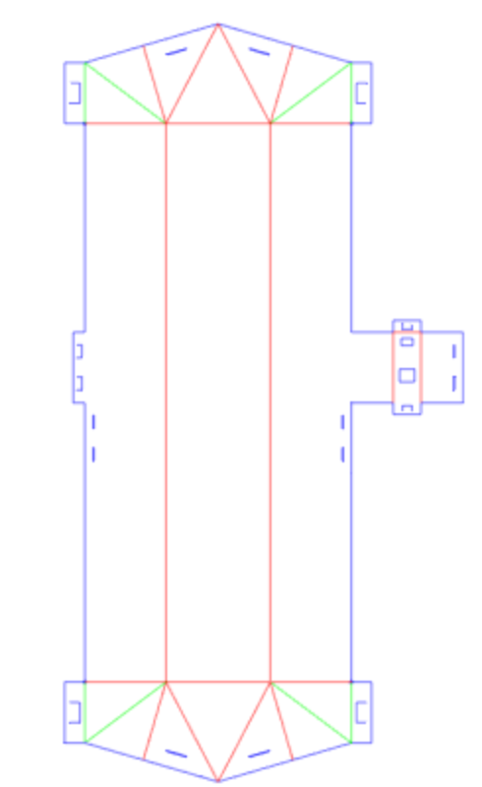
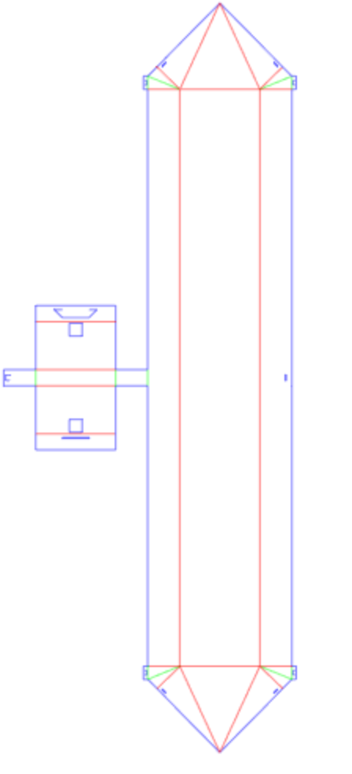
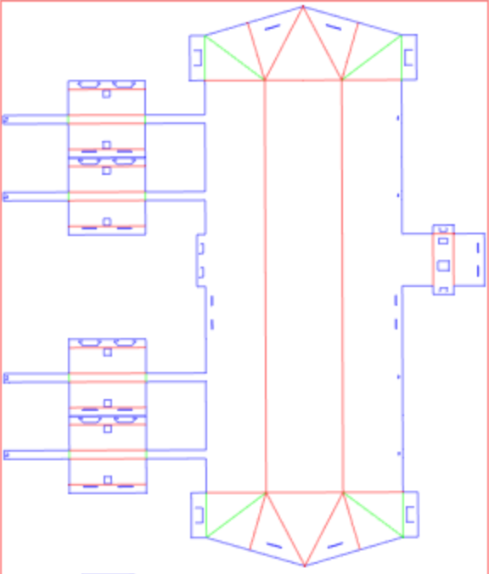
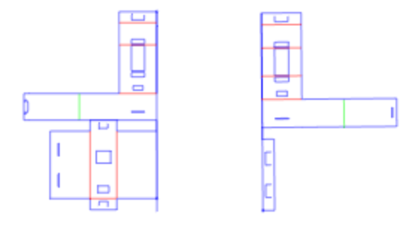
Modularity

Slide 13

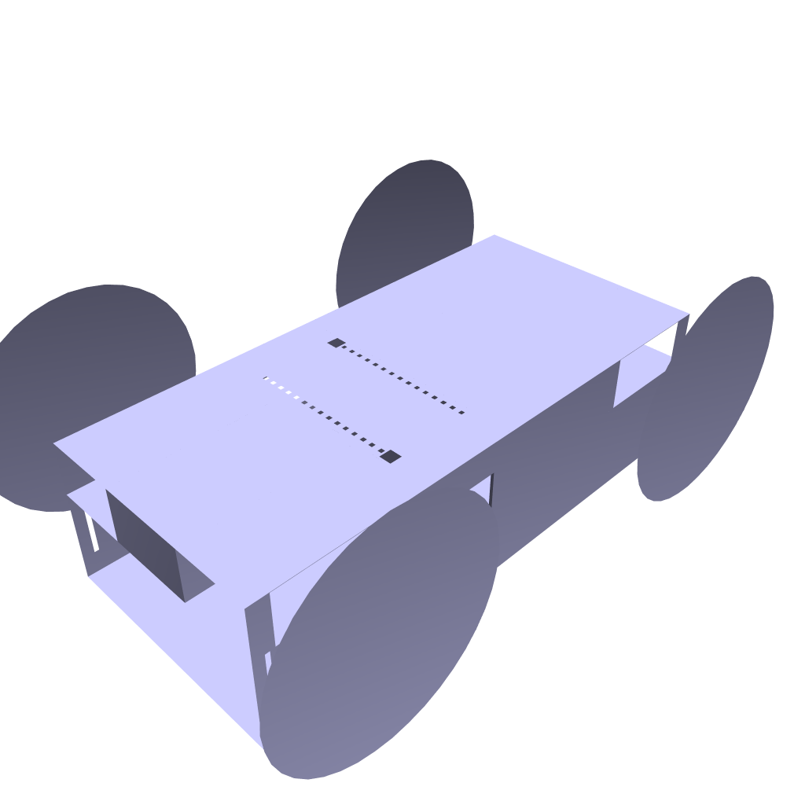
Future work
Amphibious vehicles
Vision processing
User control

Slide 14
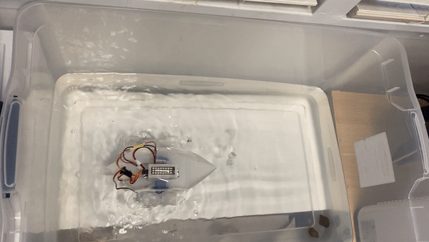
Conclusion
Contact:
gracekwak@ucla.edu
Base Designs
Modularity
Parameterization
Theoretically possible designs

